Slide 1

Hashing Techniques: Concept of Hashing, Collision resolution Techniques used in Hashing
Data Structure | Searching and Sorting
Course: Data Structure | Chapter: Searching and Sorting | Program: Bachelor of Engineering
DISCOVER · LEARN · EMPOWER
Notes:
Welcome everyone to today's lecture on Hashing Techniques. We are diving deep into Unit-3, specifically focusing on Searching and Sorting algorithms. By the end of this session, you will master how to achieve constant time complexity for data retrieval. Let us begin our journey into the world of hash tables.

Slide 2
Course Outcomes
SLIDE 2 / 10
Course Outcome
CO | BT LEVEL | DESCRIPTION
CO1 | BT1 | Understand and apply basic data structures, algorithms, complexity analysis, ADTs, arrays and linked lists.
CO2 | BT2 | Apply and implement stacks and queues in problem-solving.
CO3 | BT3 | Analyse and apply searching, sorting, and hashing techniques.
CO4 | BT4 | Construct and apply tree structures and traversal techniques.
CO5 | BT5 | Represent and solve graph problems using DFS, BFS, and graph algorithms.
Chandigarh University
2 / 10
Notes:
Today's lecture directly addresses our Course Outcomes. CO1 is covered as we apply hashing algorithms and analyze their complexity compared to linear search. While CO5 focuses on graphs, the underlying logic of mapping keys to values in hashing is a fundamental concept used in graph traversal algorithms like BFS.

Slide 3
Learning Objectives
SLIDE 3 / 10
Learning Outcomes
1
Analyze the concept of hashing and its role in efficient data retrieval.
2
Evaluate different hash functions and their impact on collision frequency.
3
Synthesize solutions for collision resolution using chaining and open addressing.
4
Compare the time complexity of linear probing versus quadratic probing.
5
Apply hash table operations to solve real-world data storage problems.
Chandigarh University
3 / 10
Notes:
Our goal is to move beyond simple definitions. You will analyze how hash functions map keys to indices and evaluate why collisions are inevitable. We will synthesize strategies to handle these collisions using chaining and open addressing. Finally, you will compare the efficiency of linear probing against quadratic probing in practical scenarios.

Slide 4
Lecture
SLIDE 4 / 10
Concept of Hashing and Hash Tables
GOVERNING EQUATION
The formula for the hash function is typically index = key % table_size
1
Hashing maps keys to specific indices in an array called a hash table.
2
The primary goal is to achieve O(1) average time complexity for search operations.
3
A hash function transforms a key into a valid array index using modulo arithmetic.
4
Direct addressing is a special case where the key itself serves as the index.
Chandigarh University
4 / 10
Notes:
Imagine you have a library where books are not on shelves but in numbered boxes. Hashing is the system that tells you exactly which box holds your book. For example, if the table size is 10 and the key is 42, the hash function 42 % 10 gives us index 2. This allows us to find data instantly without scanning the entire list.

Slide 5
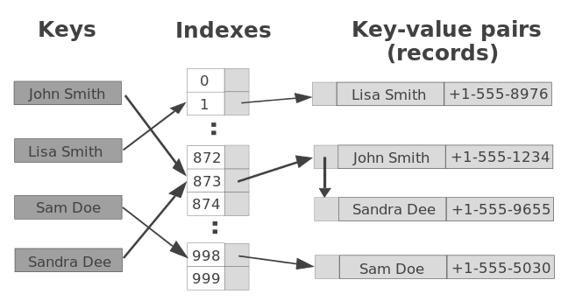
Lecture
SLIDE 5 / 10
Understanding Collisions in Hashing
1
A collision occurs when two distinct keys map to the same hash table index.
2
Collisions are inevitable because the number of possible keys exceeds the table size.
3
The frequency of collisions depends on the quality of the hash function used.
4
A poor hash function clusters keys together, degrading performance significantly.
5
The load factor (α) measures how full the table is and affects collision probability.
Source: yourbasic.org
Chandigarh University
5 / 10
Notes:
Even with a good hash function, collisions will happen. Consider a table of size 10 where keys 10 and 20 both map to index 0. This is a collision. If we have many such collisions, our search time degrades from O(1) to O(n), which is worse than a simple list. The load factor, calculated as the number of elements divided by the table size, helps us predict this risk.

Slide 6
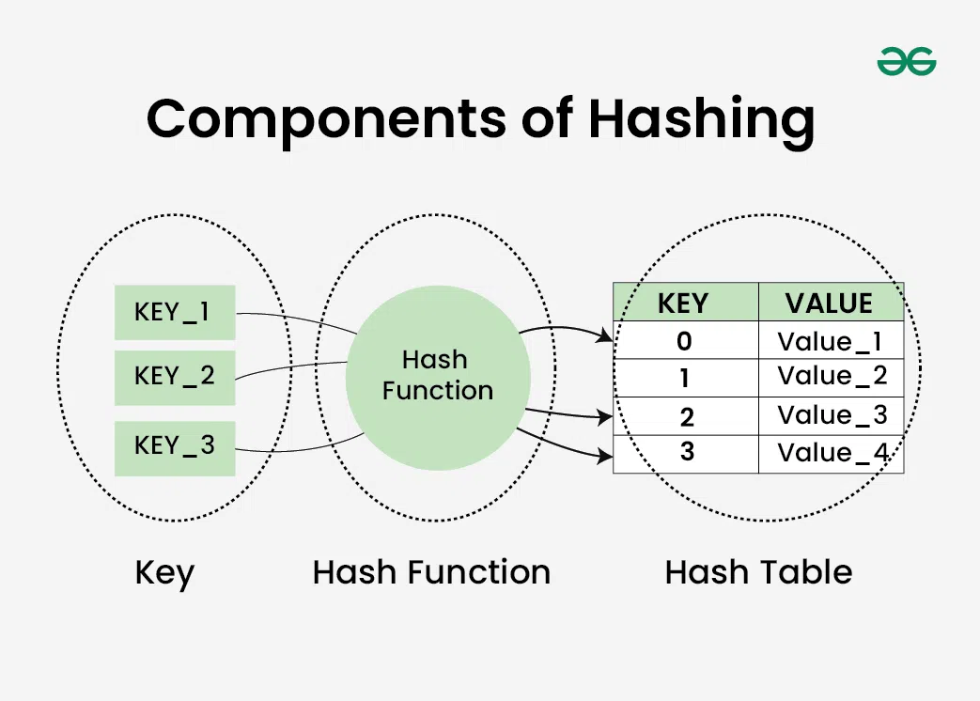
Collision Resolution
SLIDE 6 / 10
Chaining Method
1
Chaining stores multiple elements at the same index using a linked list.
2
Each bucket in the hash table points to the head of a linked list.
3
New elements are inserted at the beginning or end of the existing list.
4
The worst-case time complexity for search is O(n) if all keys collide.
5
Chaining handles high load factors well without requiring table resizing immediately.
Source: media.geeksforgeeks.org
Chandigarh University
6 / 10
Notes:
In chaining, we simply attach a linked list to every bucket. If index 5 already has a node, we just add the new node to that list. For instance, if keys 5, 15, and 25 all hash to index 5, they form a chain. This method is robust because it never fails to insert a new element, regardless of how full the table becomes.

Slide 7
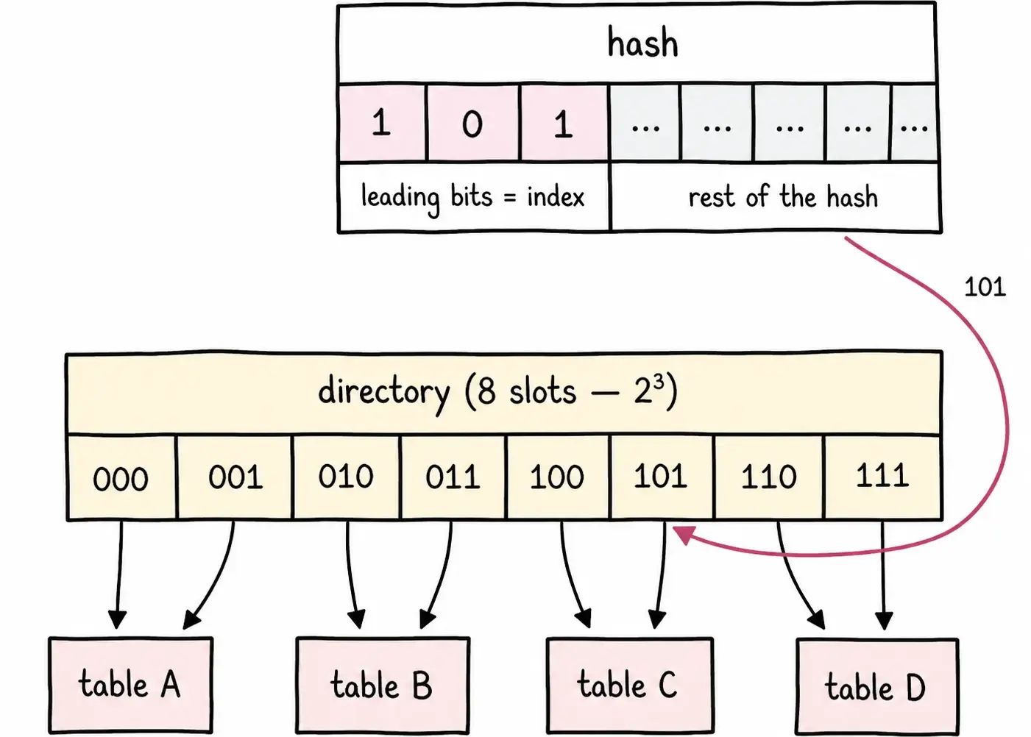
Collision Resolution
SLIDE 7 / 10
Open Addressing
1
Open addressing stores all elements directly within the hash table array.
2
When a collision occurs, the algorithm probes for the next available slot.
3
The table must be kept partially empty to ensure successful insertion.
4
Common probing strategies include linear, quadratic, and double hashing.
5
Deletion in open addressing is complex and often requires lazy deletion markers.
Source: internals-for-interns.com
Chandigarh University
7 / 10
Notes:
Unlike chaining, open addressing keeps everything inside the array. If index 3 is occupied, we check the next slot, say index 4. If that is also full, we continue probing. This method saves memory overhead from pointers but requires careful management of the table size to avoid clustering, where groups of filled slots form.

Slide 8
Lecture
SLIDE 8 / 10
Linear Probing Technique with Example
EXAMPLE
Inserting key 10 into index 0, then 20 into index 0 causes a collision.
• Linear probing checks the next slot sequentially: (hash(key) + i) % table_size.
• It is simple to implement but suffers from primary clustering issues.
• With linear probing, 20 moves to index 1, and 30 moves to index 2.
• The formula for the i-th probe is (h(k) + i) % m where m is table size.
Chandigarh University
8 / 10
Notes:
Let's look at a concrete example. If we insert 10, it goes to index 0. If we then insert 20, and the hash function also maps it to 0, linear probing moves it to index 1. If 30 also hashes to 0, it goes to index 2. This creates a cluster of filled slots, making future insertions slower as we scan through the cluster.

Slide 9

Lecture
SLIDE 9 / 10
Key Takeaways
1
Hashing provides O(1) average time complexity for search, insert, and delete operations.
2
Collisions are unavoidable and must be resolved using chaining or open addressing.
3
Chaining uses linked lists to handle multiple keys at a single index.
4
Open addressing probes for the next available slot within the array itself.
5
Linear probing is simple but prone to clustering, while quadratic probing reduces this.
Source: ecdn.teacherspayteachers.com
Chandigarh University
9 / 10
Notes:
To summarize, hashing is the most efficient way to store and retrieve data if implemented correctly. You must understand that collisions are a natural part of the process. Choose chaining for simplicity and handling large datasets, or open addressing for memory efficiency. Remember that the choice of hash function and collision resolution strategy dictates your system's performance.

Slide 10
Lecture
SLIDE 10 / 10
References
DATA STRUCTURES
A Pseudocode Approach with C — Gilberg, Forouzan
• Data Structures — Lipschutz
• Data Structure Using C — AK Sharma
• C and Data structure — P. S. Deshpandey
Chandigarh University
10 / 10
Notes:
For further reading and deeper understanding of these concepts, please refer to the listed textbooks. Gilberg and Forouzan provide excellent pseudocode approaches, while Lipschutz offers a comprehensive theoretical foundation. AK Sharma and P. S. Deshpandey are also excellent resources for C implementations. Thank you for your attention.

